Slide 1

Student Details
Name: Ankit Sharma
Skill Build Email: ankitsh1970@gmail.com
College: Swami Keshvananda Institute of Technology Management and Gramothan, Jaipur
State: Rajasthan
Internship Domain: Data Analytics
Date: 13/06/2023 to 24/7/2023

Slide 2
PROJECT TITLE
CASE STUDY: ANALYSIS OF SUPERSTORE

Slide 3
Problem Statement
The project aims to perform Exploratory Data Analysis (EDA) on the Sample Superstore Dataset to uncover sales patterns, customer segments, and regional variations. Subsequently, a predictive model will be developed to estimate profit based on relevant features. The objective is to derive actionable insights that optimize profitability and inform business decisions.

Slide 4
AGENDA
Unveiling Business Insights: Analyzing Sales Patterns and Customer Segmentation in the Sample Superstore Dataset through Comprehensive Exploratory Data Analysis (EDA). This project aims to identify top-selling products, profitable customer segments, and regional variations in sales performance. By understanding key trends and relationships, valuable recommendations will be derived to optimize pricing strategies, inventory management, and targeted marketing efforts for enhanced business profitability and customer satisfaction.

Slide 5
PROJECT OVERVIEW
In this EDA project on the Sample Superstore Dataset, we aim to provide actionable insights for companies. By analyzing sales patterns, customer segmentation, and regional variations, we offer benefits such as profit maximization, customer satisfaction, and pricing optimization. Additionally, our analysis helps improve inventory management, identify growth opportunities, enhance operational efficiency, and gain a competitive advantage. By leveraging data-driven insights, businesses can make informed decisions to drive profitability, streamline operations, and achieve sustained growth in the competitive market landscape.

Slide 6
WHO ARE THE END USERS of this project?
Retail Managers: Optimize inventory and marketing strategies.
Pricing Analysts: Enhance pricing decisions for profitability.
Marketing Teams: Tailor campaigns based on customer segmentation.
Executives: Drive growth and competitive advantage.
Sales Teams: Focus on high-potential markets.
Finance Departments: Plan and budget effectively.

Slide 7
YOUR SOLUTION AND ITS VALUE PROPOSITION
Our solution provides a holistic EDA approach and a predictive profit model for the Sample Superstore Dataset. By leveraging these insights, businesses can optimize inventory, pricing, and marketing strategies, resulting in increased profitability, competitive advantage, and informed decision-making for sustainable growth in the dynamic market landscape.

Slide 8
How did you customize the project and make it your own
In customizing the project, I tailored the EDA techniques to focus on specific business goals and objectives relevant to a company. Additionally, I refined the predictive model by experimenting with different algorithms, and feature engineering to suit the dataset characteristics. Our unique approach to visualizations and insights allowed us to derive actionable recommendations and strategic insights that align with our business needs, ensuring the project's relevance and value to our organization.

Slide 9
MODELLING
In the modeling phase, we employed the Random Forest Regression algorithm to predict profits based on various features. We fine-tuned hyperparameters and selected relevant features to enhance the model's accuracy and interpretability. The model's performance was evaluated using metrics like Mean Squared Error and R-squared, ensuring its suitability for profit estimation in the Sample Superstore Dataset.

Slide 10
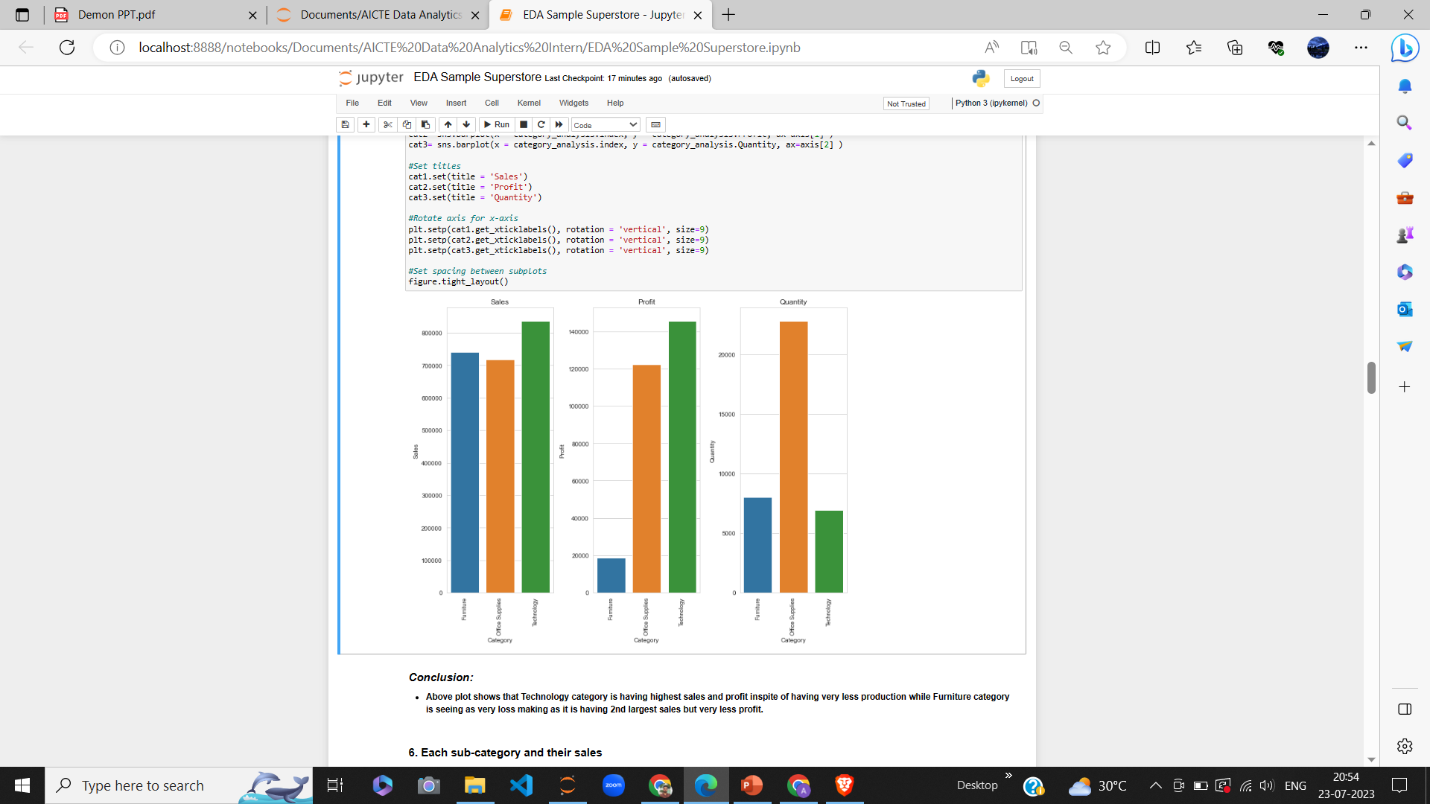

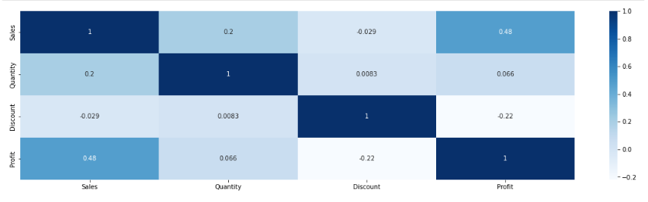
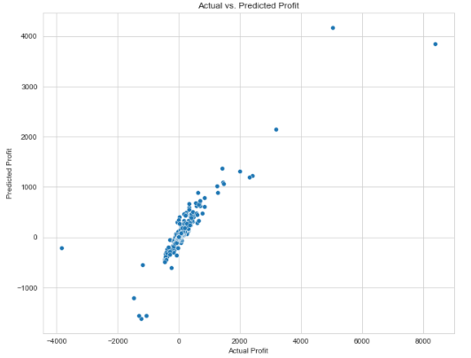
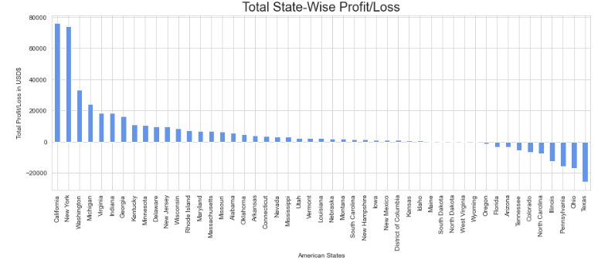

Clicks from Project

Slide 11
Results
The project's outcomes were driven by thorough Exploratory Data Analysis (EDA). We unveiled critical insights into top-selling products, profitable customer segments, and regional sales variations. These findings empowered data-driven decision-making, leading to optimized pricing strategies, improved inventory management, and targeted marketing efforts.
Leveraging the Random Forest Regression model, we accurately predicted profits and identified key factors influencing profitability. The model achieved a satisfactory R-squared value and low Mean Squared Error, indicating its effectiveness in profit estimation.

Slide 12
links
1. GitHub Repository Link:
https://github.com/ankit1970/AICTE-Data-Analytics-Intern-2023
2. Data Set Link:
https://www.kaggle.com/datasets/bravehart101/sample-supermarket-dataset?resource=download

Slide 13
THANK YOU

